Slide 1
Unveiling the Impact: Visualizing Layoffs in Tech (2020-2024)
By Gregory Celestino, Fernando Perez, Dylan Tomasello, Jacob Valenzuela

Slide 2
Introduction & Significance
In 2020, the Covid-19 pandemic caused a near global lockdown. People across the world were stuck in their homes. While many industries struggled, many spaces in the tech industry surged, such as online retail, food delivery systems and home entertainment. This huge demand led to rapid growth for many companies.
As the world reopened, virtually all spaces in the tech space saw a decline in their profits. This has led to massive layoffs from small companies to tech giants such as Google and Microsoft.
Our goal is to look at the raw data regarding these layoffs and to see if this is a flash in the pan downswing, or a continual decline in this industry.
Notes:
In 2020, the covid-19 pandemic resulted in a near global lockdown, and across the world, people found themselves suddenly stuck inside of their homes. While many industries that relied on their brick and mortar business struggled, many spaces in the tech industry saw a huge spike in business. In particular, businesses such as food delivery services, online retail and home entertainment saw a huge increase in demand, which led to a need for rapid growth.
As the world began to return to normal activities, nearly every sector within the tech industry experienced a decrease in their earnings. Consequently, numerous layoffs occurred affecting everyone from small enterprises to tech giants such as Google and Microsoft.
Our goal with this presentation is to examine the data concerning these job cuts to determine whether this downturn is merely temporary or indicative of an ongoing decline in this sector.

Slide 3

Our Audience
As our class is made up mostly of students who will be graduating as soon as next month, many of which are hoping to enter the job market, these massive shake ups in the tech industry directly affect all of us.
Notes:
Our target audience for this presentation are CS students like ourselves. Our class consists predominantly of students who will graduate in the next month, and with many aspiring to enter the job market, the significant disruptions occurring in these businesses directly impacts each and every one of us.

Slide 4

About our Dataset
Our data comes from https://layoffs.fyi/
Internet entrepreneur Roger Lee independently began tracking tech layoffs post Covid-19
It contains companies, company locations, layoffs
It contains info on 574,471 firings that have occurred in the last 4 years
Notes:
Our dataset originates from layoffs.fyi, a website established by internet entrepreneur Roger Lee to monitor significant tech layoffs post-COVID-19. It encompasses information on companies, their locations, and the extent of the layoffs that occurred. This database encompasses over 550,000 layoffs documented within the past four years.

Slide 5

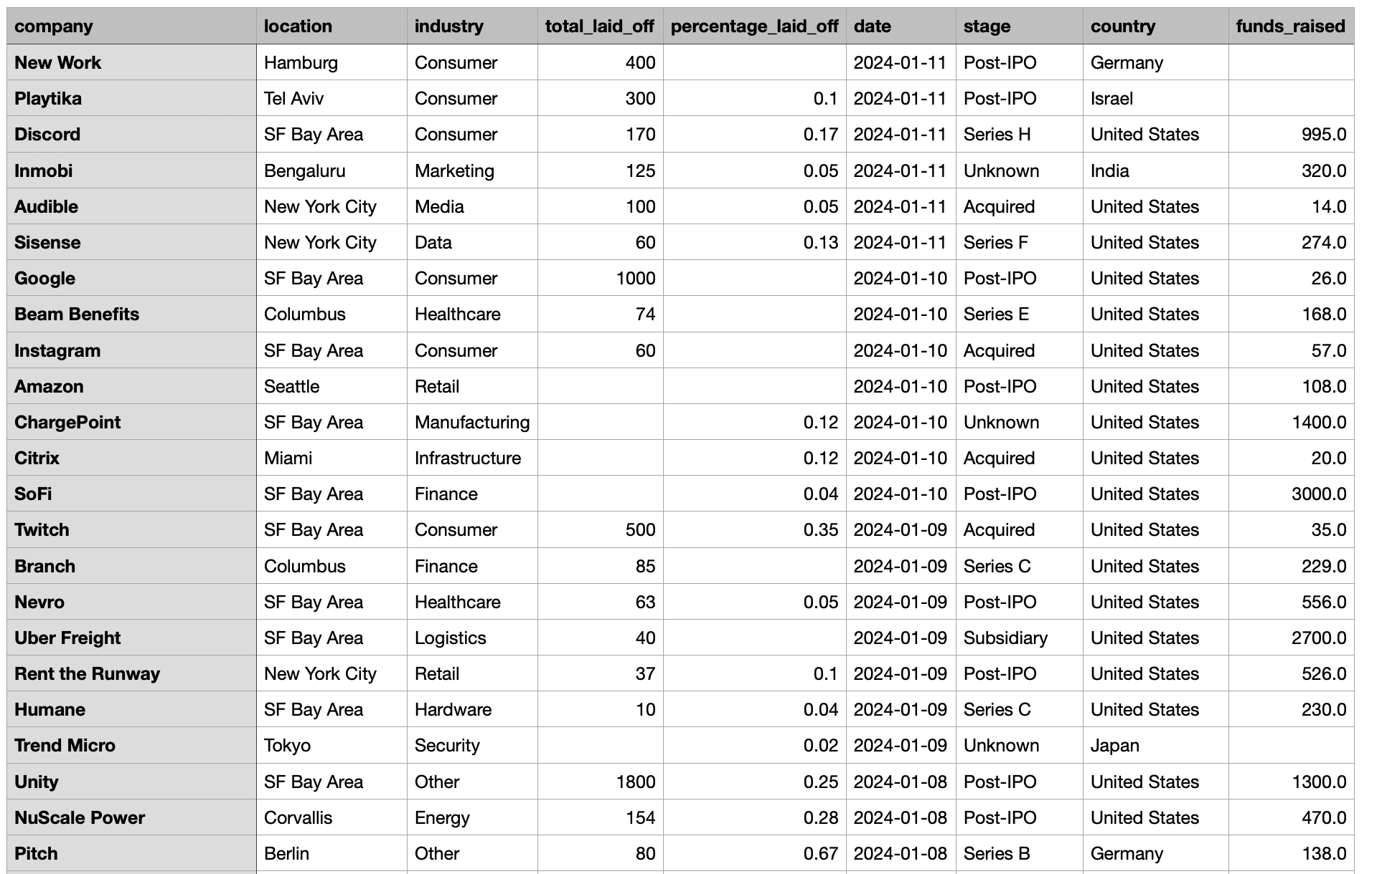
Dataset Overview
Notes:
Our dataset contains data on more than 3000 instances of layoffs spanning over the past four years. It includes information on companies, locations, industries, layoff counts in both absolute numbers and as a percentage relative to the company's overall size, the dates of the layoffs, and the current business stage of the companies involved.

Slide 6
Data Cleaning and Preprocessing
No preprocessing or cleaning was found to be necessary for this data set.
Notes:
While the dataset did contain missing values, we found no need for preprocessing the data for the purposes of this presentation.

Slide 7
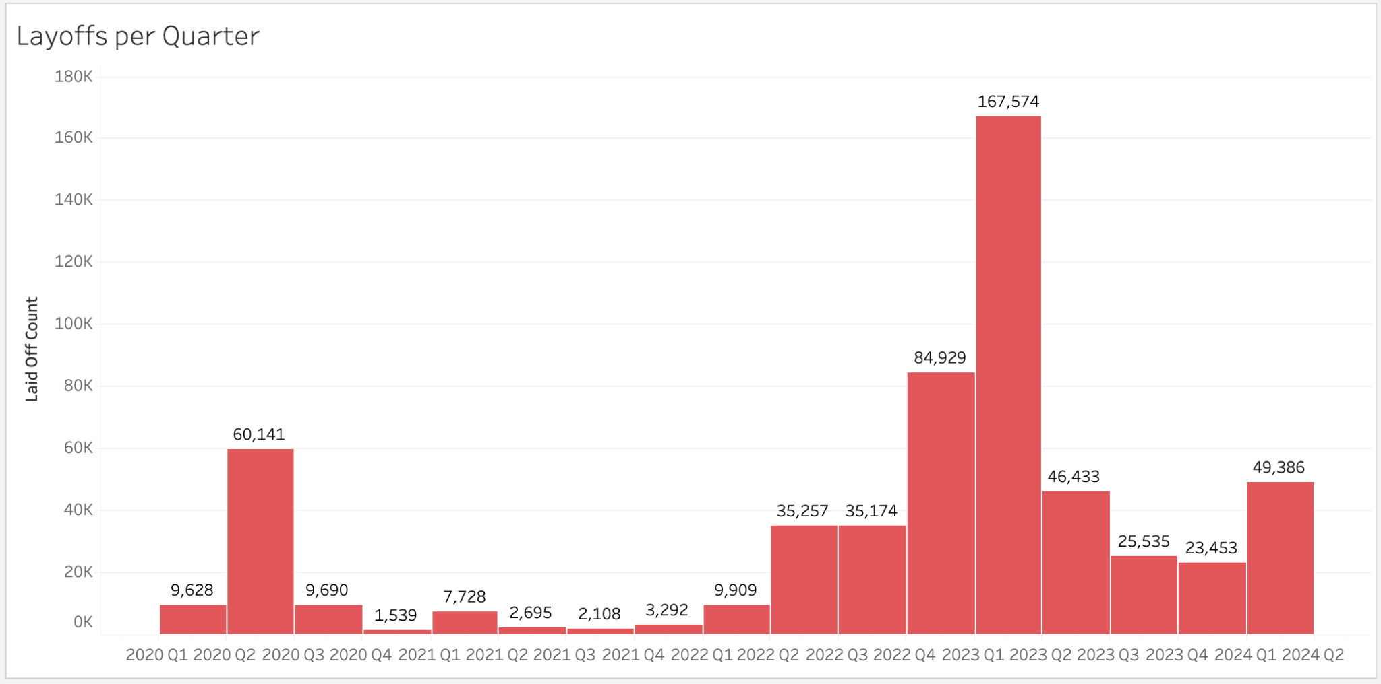
Layoffs per Quarter
Purpose
A bar graph showing the number of layoffs in the tech industry by sales quarter.
Encoding
Label: Sum(Laid Off Count)
Columns: Quarter(Date)
Rows: Sum(Laid Off Count)

Slide 8
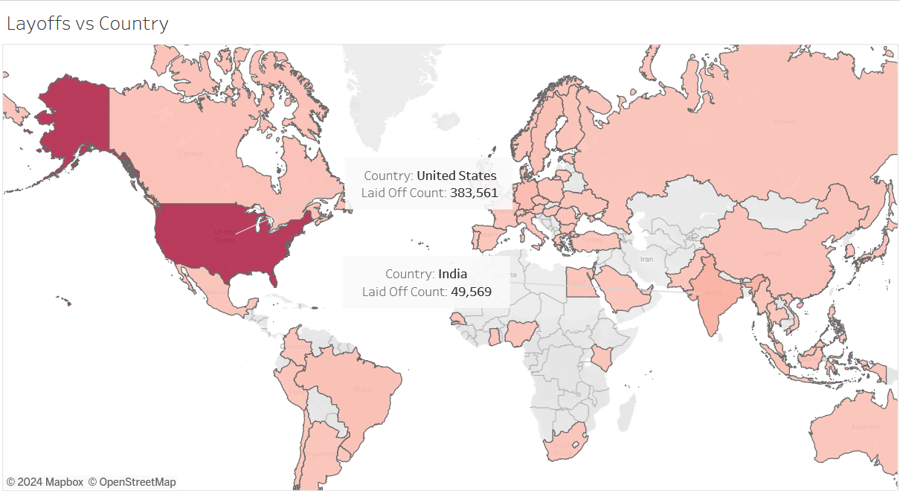
Layoffs vs Country
Purpose
A choropleth map that visualizes the distribution of layoffs between each countries.
Encoding
Color: Sum(Laid Off Count)
Label: Country

Slide 9
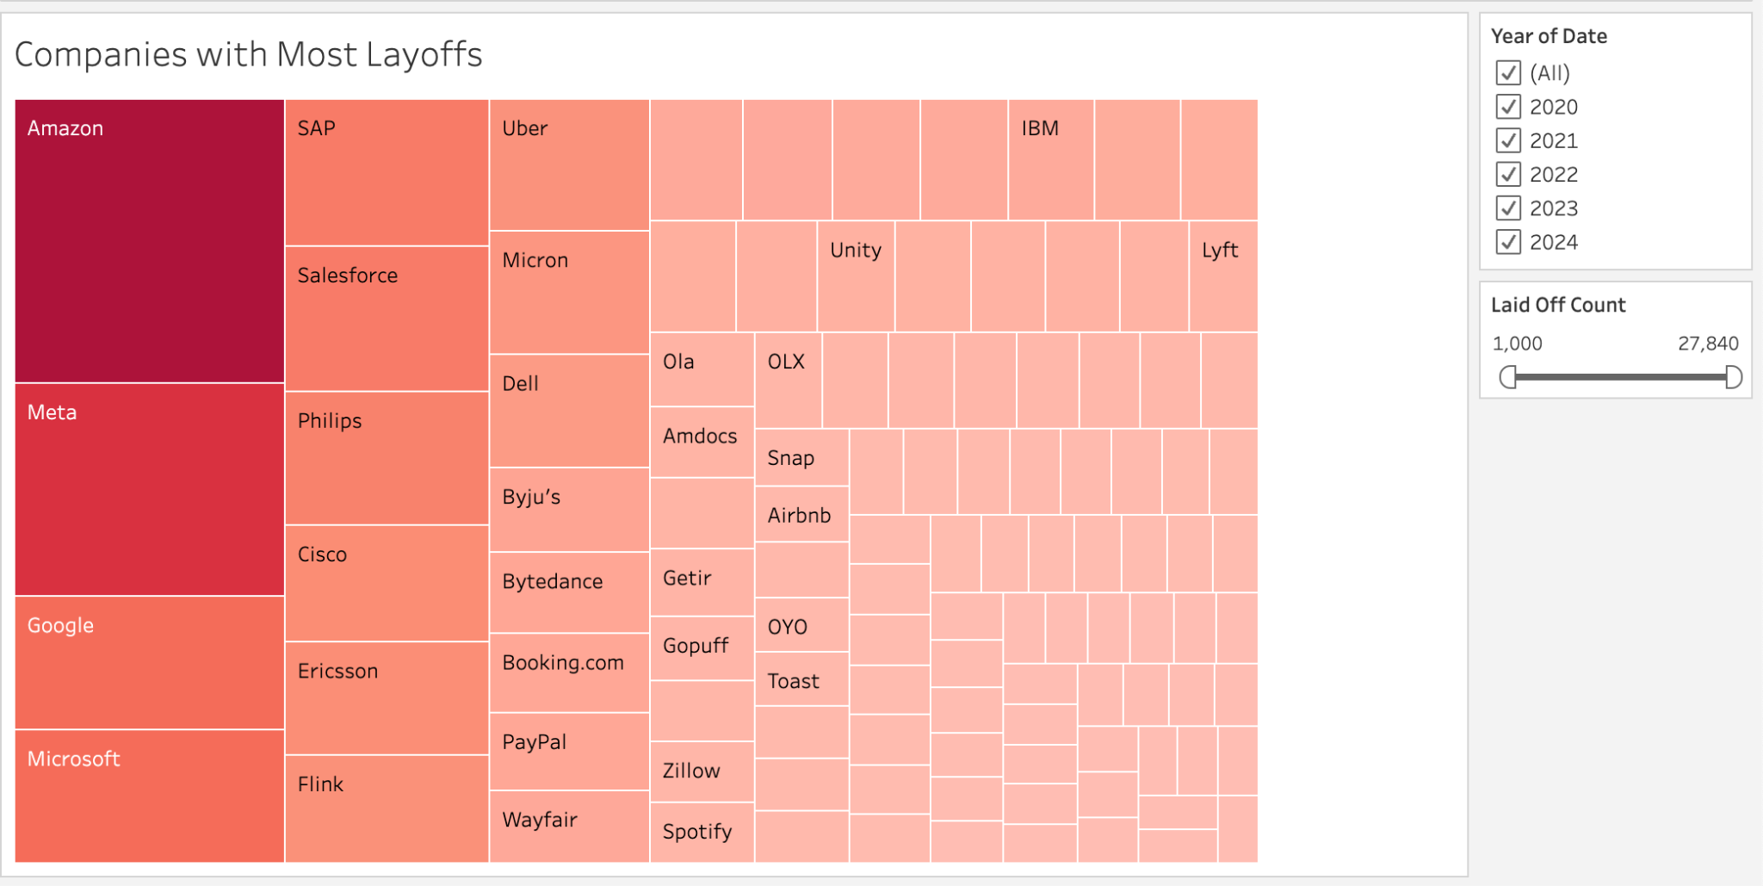
Companies with Most Layoffs
Purpose
A tree map showing the companies with the most layoffs since the Covid-19 epidemic. Filters allow for user interactivity.
Encoding
Color: Sum(Laid Off Count)
Size: Sum(Laid Off Count)
Label: Company
Tooltip: Industry
Filter: Year
Filter: Sum(Laid Off Count)

Slide 10
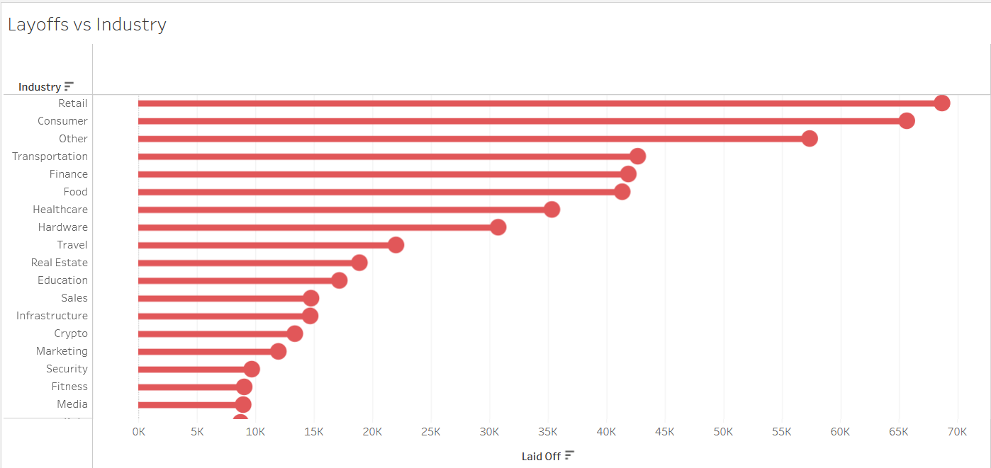
Layoffs vs Industry
Purpose
A Lollipop Chart showing the amount of layoffs each industry has had thus far.
Encoding
Length: Sum(Laid Off Count)
Label: Industry

Slide 11
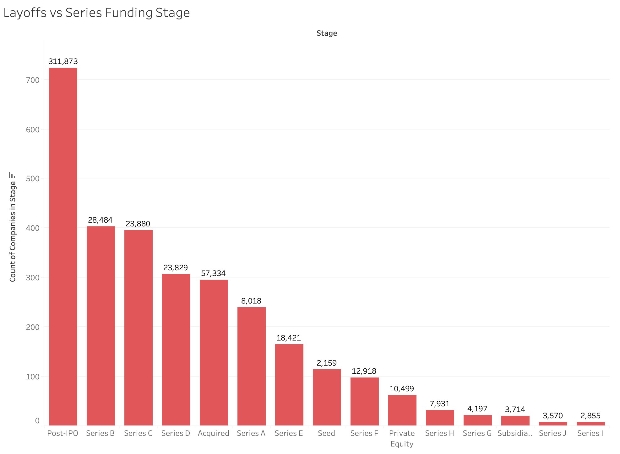
Layoffs vs Series Funding Stage
Purpose
A bar graph labeling the count of layoffs in comparison to the Series Funding Stage
Encoding
Label: Sum(Laid Off Count)
Columns: Stage
Rows: CNT(Stage)

Slide 12

Live Demo
Tableau Public Live Demo

Slide 13

Findings and Insights
Layoffs peaked at around the beginning of 2023, between the first and second quarters.
There was a smaller yet significant spike in layoffs during the beginning of the covid lockdown in 2020.
Most Layoffs occurred in the United States of America.
The company that fired the most employees these past 4 years was “Amazon”
The industry that suffered the most layoffs was “retail” and the industry that suffered the least amount of layoffs was “AI”
Layoffs were most likely to happen within a company during the “Post-IPO” funding stage.

Slide 14

Extensions and Future Work
Future Database Connections
Implementing Gross Domestic Product(GDP) Impacts
Tracking Locational Layoffs
Homelessness Surge
High-Risk Industry Sustainability
This can serve as a well structured foundation for other work in the fields of computer science
Natural Language Techniques
Machine Learning

Slide 15
References
Kaggle Data Source
Layoffs Data source
Tech Company Layoffs: The COVID Tech Bubble Bursts
What Are the Series Funding Stages

